Slide 1
Basics: Driver Control

Slide 2
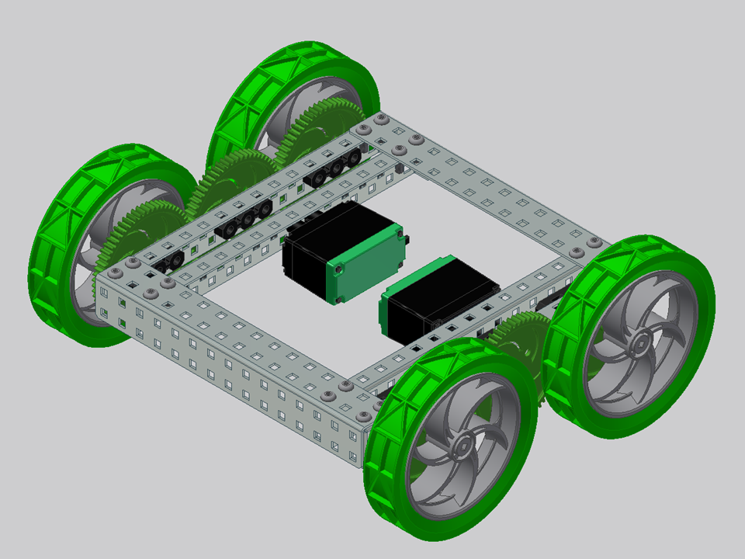
In this PowerPoint you will be introduced to programming driver control with one or two joysticks. This powerpoint assumes a robot with four wheels in a rectangular shape. (H-drive, X-drive, and Mecanum drive will be introduced in a future PowerPoint.)
Something like this!

Slide 3

To start with, let’s take a look at the VEX remote controller.
There are four axis on two separate joysticks: On the left side, channel 4 as the horizontal axis, and channel 3 as the vertical axis. On the right side, channel 1 as the horizontal axis, and channel 2 as the vertical axis.
4
1
3
2

Slide 4
Two-Joystick Drive

Slide 5
With the two-joystick drive, you want channel 3 to control the left side of the robot, and channel 2 to control the right side of the robot.
3
2

Slide 6
The joysticks output different numbers as they are pushed to different points on the axis. For the horizontal axis, right is positive, up to 127, and left is negative, down to -127. For the vertical axis, up is positive, and down is negative, to the same range of values
It’s very convenient that the joystick outputs are the same range of numbers that we need for motor inputs. Therefore, we can set a motor to a channel and it will turn according to the reading on that channel of the joystick.
+
-
+
0
1
-
2

Slide 7
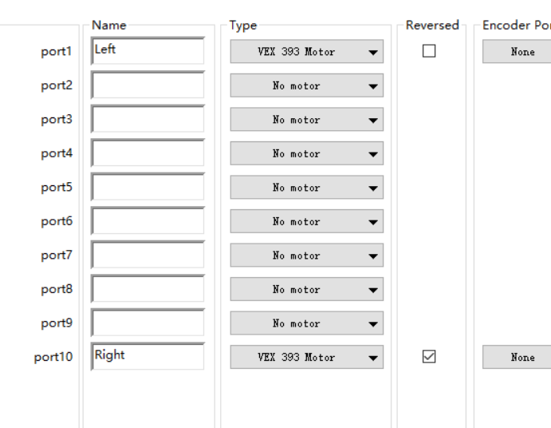
Open RobotC and start a new file. Under “motor and sensor setup”, set the names and types for your motor. (This is my setup, your setup can be different if using a different robot.)
Since the left and right side motors are running in opposite ways, you need to reverse one of them so they both go forward when receiving a positive power value. Usually, the right side of the drive base is reversed.

Slide 8
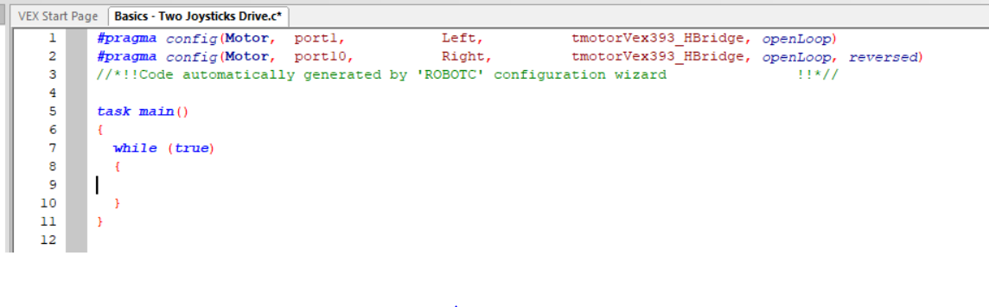
Start by setting up a while (true) loop, including its closing brace. This should be the first step of most driver controlled programs, as you will need the code to repeat itself infinite times.
Type all the driver code inside this while loop!!! Any code after the closing brace for the while (true) loop will not be run, since the loop continues forever!

Slide 9
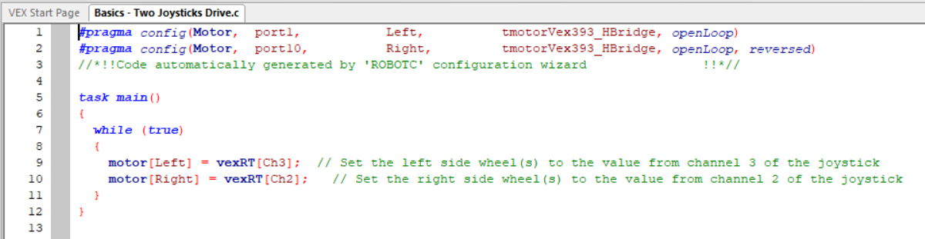
Inside the while(true) loop, set the motors to equal the value from channels of the joystick. Left side should equal channel 3, and right side should equal channel 2.
vexRT stands for VEX Remote Transmission. It is used whenever you are using an output from the remote controller.
vexRT[Ch3]: [] square brackets specify which one. Ch3 stands for channel 3, which is the label of the channel you are using. The C in Ch3 has to be capitalized, otherwise you will get an error.

Slide 10
Double check your motor configuration is the same on the robot as on the code. Then download the code and try it out!
Each side of the joystick should control one motor, and forward on one joystick should be forward on that side of the bot.
Congrats if it is working!

Slide 11
One-Joystick Drive

Slide 12
With the one-joystick drive, you want channel 2 to control the forward and backward motion, and channel 1 to control turning left and right.
It can work the same with channel 4 and 3.
1
2

Slide 13
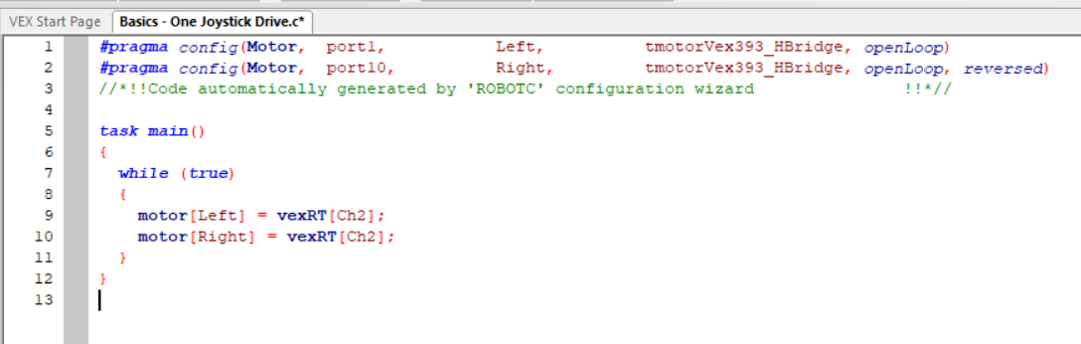
The single joystick drive code actually builds on the two-joystick drive code. To start with, set up and reverse the motors, set up a while (true) loop and type in similar code as the one for two-joystick drive.
However, since the forward and backward motion of both sides will be controlled by channel 2, you should set both motors to equal channel 2.
If you download this code right now, the robot should only be able to go back and forth based on channel 2.

Slide 14
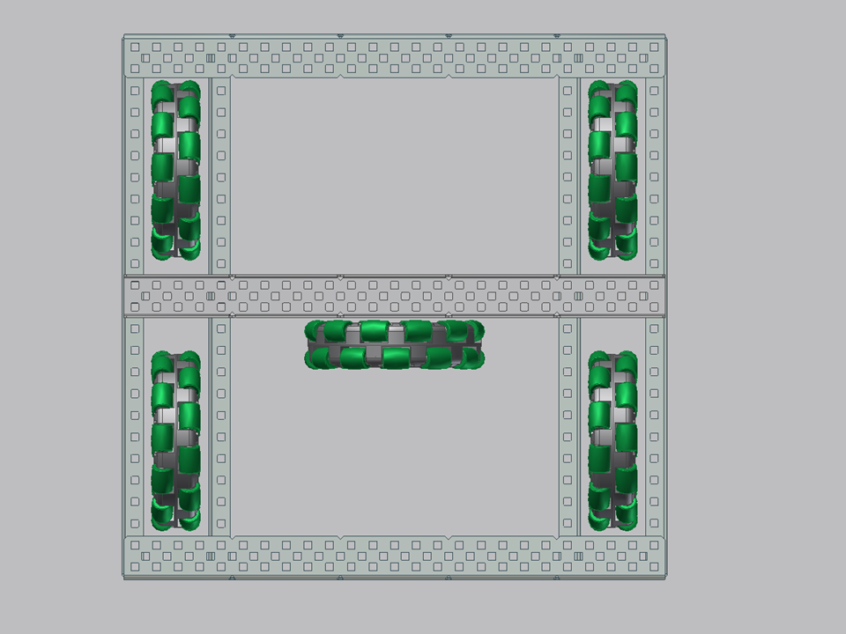
Now onto turning. Let’s analyse it case by case:
When channel 1 is positive, the robot should turn right. And to turn right, we need the left side to go forward (positive power), and right side to go backwards (negative power).
1

Slide 15
When channel 1 is negative, the robot should turn left. And to turn left, we need the left side to go backwards (negative power), and right side to go forward (positive power).
1

Slide 16
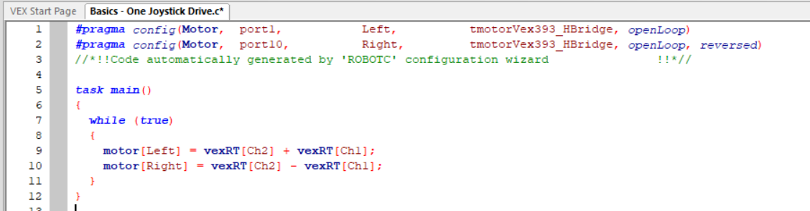
Therefore, the left side power is the same as the joystick;
the right side power is opposite / negative of the joystick value.
To do that in code, you need to add or subtract the value of channel 1 from channel 2.
For the left side which is the same, add channel 1.
For the right side which is opposite, subtract channel 2.

Slide 17
Download this code and try it out!
With different robots, you may have more than one motor on one side, and sometimes they will be reversed differently. Reverse the motors so that the robot goes forward with channel 2, and then work on the turning part.
Mecanum wheels and X-Drive will be different! This is for rectangular shaped drive base that uses normal wheels.

Slide 18
Thank you for viewing and hopefully this PowerPoint will help you with programming the drive base of your robot.
The drive base (especially later on as we talk about X-Drive) can require a bit of knowledge with directions and vectors. The easy way to go about it for me is to imagine you are the robot going one direction, figure out the signs for that direction, make that segment of code, and lastly piece them altogether. It definitely helps to sketch a picture too.
If you have any questions or found a mistake of mine, please email alicexxx0516@gmail.com. Love to help or improve together.
2018.03.28
Alice Xiong

